Slide 1
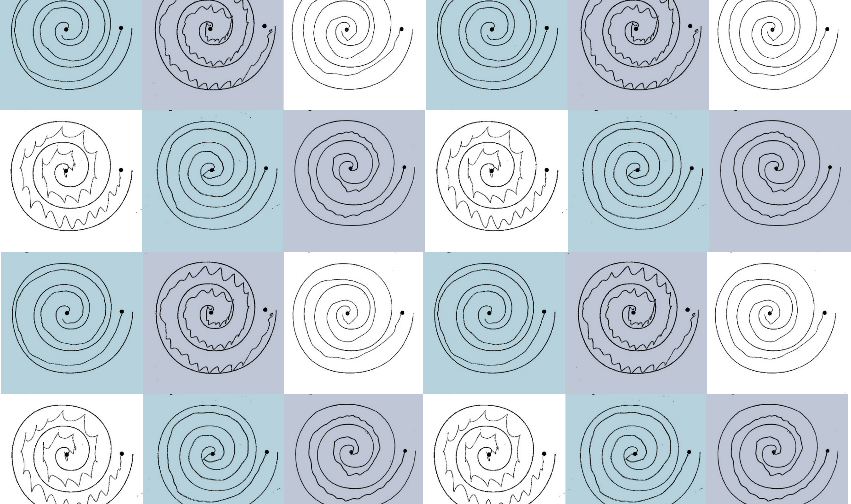
Which Hand?
Robyn Gebbie and Jesse van der Merwe
22P59

Slide 2
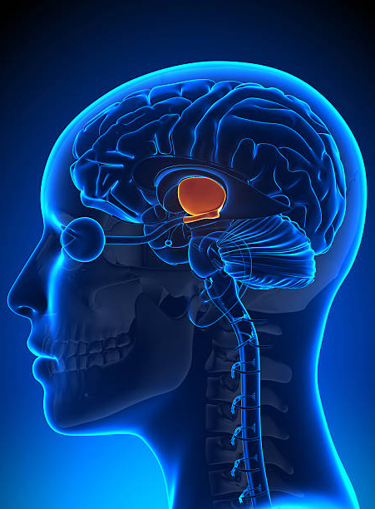
Focused Ultrasound Treatment
Focused Ultrasound is used to treat Parkinson’s Disease and Essential Tremor
This treatment delivers acoustic energy to one side of the patient’s thalamus
This process causes small lesions to form on this part of the brain, interrupting abnormal brain activity and causing the patient to have fewer uncontrollable movements, such as tremor
This treatment only improves the tremor on one side of the patient’s body

Slide 3
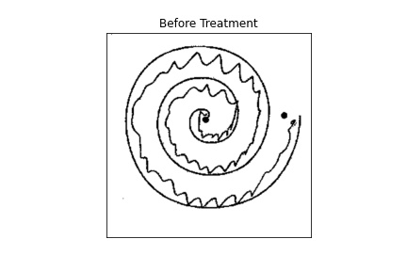
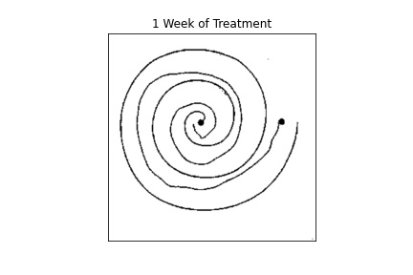
Before Treatment
After Treatment

Slide 4
Spiral Tremor Quantification
Preparation
Images were resized.
x and y coordinates of the spiral pixels were extracted.
Sobel Edge Detection
The angles made by the gradients of the spiral edges were determined
Pixel Angles
The angle that each pixel made with a horizontal line through the spiral centre was determined
Relative Orientations
The angles made by the gradients of the spiral edges relative to the centre of the spiral was determined.

Slide 5
Spiral Tremor Quantification
Preparation
Images were resized.
x and y coordinates of the spiral pixels were extracted.
Sobel Edge Detection
The angles made by the gradients of the spiral edges were determined
Pixel Angles
The angle that each pixel made with a horizontal line through the spiral centre was determined
Relative Orientations
The angles made by the gradients of the spiral edges relative to the centre of the spiral was determined.

Slide 6
Spiral Tremor Quantification
Preparation
Images were resized.
x and y coordinates of the spiral pixels were extracted.
Sobel Edge Detection
The angles made by the gradients of the spiral edges were determined
Pixel Angles
The angle that each pixel made with a horizontal line through the spiral centre was determined
Relative Orientations
The angles made by the gradients of the spiral edges relative to the centre of the spiral was determined.

Slide 7

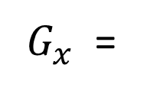
Vertical Sobel Filter Convolved with Image Array
-4
-3
-2
-1
0
1
2
3
4
-5
-4
-3
-2
0
2
3
4
5
-6
-5
-4
-3
0
3
4
5
6
-7
-6
-5
-4
0
4
5
6
7
$G_{x}$ =
-8
-7
-6
-5
0
5
6
7
8
$$∗$$
-7
-6
-5
-4
0
4
5
6
7
-6
-5
-4
-3
0
3
4
5
6
-5
-4
-3
-2
0
2
3
4
5
-4
-3
-2
-1
0
1
2
3
4

Slide 8

Calculation of the Orientation of an Edge Gradient
$$φ$$

Slide 9
Spiral Tremor Quantification
Preparation
Images were resized.
x and y coordinates of the spiral pixels were extracted.
Sobel Edge Detection
The angles made by the gradients of the spiral edges were determined
Pixel Angles
The angle that each pixel made with a horizontal line through the spiral centre was determined
Relative Orientations
The angles made by the gradients of the spiral edges relative to the centre of the spiral was determined.

Slide 10
Finding the Spiral Centre

Slide 11

Finding the Angle a Pixel Makes with the Spiral Centre
$$α$$

Slide 12
Spiral Tremor Quantification
Preparation
Images were resized.
x and y coordinates of the spiral pixels were extracted.
Sobel Edge Detection
The angles made by the gradients of the spiral edges were determined
Pixel Angles
The angle that each pixel made with a horizontal line through the spiral centre was determined
Relative Orientations
The angles made by the gradients of the spiral edges relative to the centre of the spiral was determined.

Slide 13
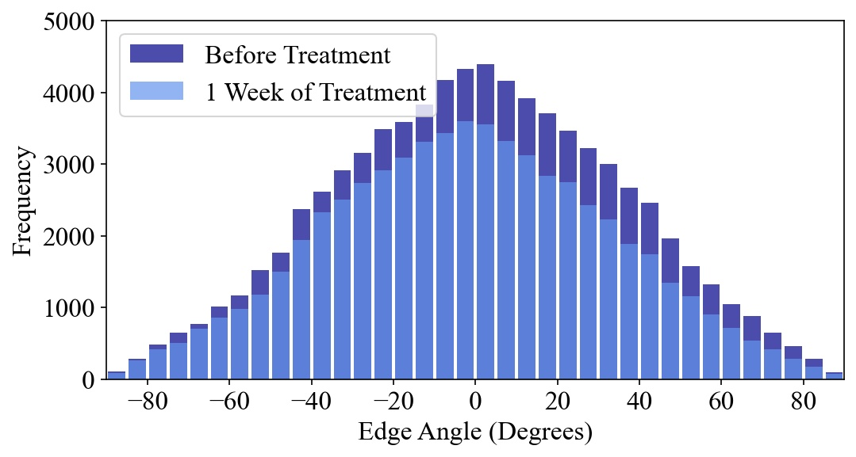
Before Treatment
After 1 Week of Treatment
Histogram of Relative Orientations From -90$°$ to 90$°$

Slide 14
Generated Dataset – Normalised Standard Deviations of Relative Orientations
Treated Hand
Patient | Before | 1 Week | 1 Month | 3 Months | 6 Months | 1 Year | 2 Years | 3 Years | 4 Years
1 | 0,698044 | 0 | 0,237717 | 0 | 0 | 0 | 0,290249 | 0 | 0
2 | 0 | 0,281558 | 0 | 0 | 0,434665 | 0,365253 | 0,503931 | 0 | 0,428059
3 | 0 | 0 | 0 | 0 | 0,252604 | 0,384334 | 0,331075 | 0 | 0,302699
4 | 0,585264 | 0 | 0,149938 | 0 | 0 | 0,294155 | 0 | 0,258329 | 0,271489
5 | 0,679568 | 0,362549 | 0 | 0,343763 | 0 | 0,409721 | 0,479966 | 0,396602 | 0,433127
6 | 0,712806 | 0 | 0,303926 | 0,499187 | 0 | 0,472451 | 0,50885 | 0 | 0,481076
7 | 0 | 0 | 0,271755 | 0 | 0,218512 | 0,333714 | 0,460889 | 0,253509 | 0,319644
8 | 0,52692 | 0 | 0 | 0 | 0 | 0,513662 | 0 | 0 | 0,336593
9 | 0 | 0,491569 | 0,472419 | 0 | 0,765778 | 0 | 0 | 0 | 0
10 | 0,539847 | 0,605008 | 0,61649 | 0 | 0 | 0 | 0,667995 | 0,668692 | 0
11 | 0 | 0 | 0 | 0 | 0 | 0 | 0 | 0 | 0
12 | 0,813568 | 0 | 0,657648 | 0 | 0,52252 | 0,462613 | 0 | 0 | 0
13 | 0,645149 | 0 | 0,119964 | 0,221157 | 0 | 0 | 0,280933 | 0 | 0
14 | 0,580098 | 0 | 0 | 0,542421 | 0 | 0 | 0,499081 | 0,50493 | 0
15 | 0,64107 | 0 | 0 | 0,383135 | 0 | 0 | 0 | 0,396786 | 0
Untreated Hand
Patient | Before | 1 Week | 1 Month | 3 Months | 6 Months | 1 Year | 2 Years | 3 Years | 4 Years
1 | 0,408867 | 0 | 0,366282 | 0 | 0 | 0,259126 | 0 | 0,503479 | 0
2 | 0 | 0,228981 | 0 | 0 | 0,428186 | 0 | 0,618255 | 0 | 0,54439
3 | 0,591579 | 0 | 0 | 0 | 0,340246 | 0,454341 | 0,209696 | 0,278048 | 0,464904
4 | 0,279079 | 0 | 0,382022 | 0 | 0 | 0,343708 | 0,372763 | 0,451237 | 0,25776
5 | 0,287888 | 0,508742 | 0 | 0,414898 | 0 | 0,576726 | 0,541957 | 0,482606 | 0,652041
6 | 0,464626 | 0 | 0,275568 | 0,484608 | 0 | 0 | 0,470062 | 0 | 0,43042
7 | 0 | 0 | 0,387976 | 0 | 0,311089 | 0,420795 | 0,502251 | 0,169325 | 0,336124
8 | 0,287094 | 0 | 0 | 0 | 0 | 0,479698 | 0 | 0 | 0,118001
9 | 0 | 0 | 0 | 0 | 0 | 0,877022 | 0 | 0 | 0
10 | 0,715809 | 0,516644 | 0,545562 | 0,369392 | 0 | 0 | 0,445001 | 0,358108 | 0
11 | 0 | 0 | 0 | 0 | 0 | 0 | 0 | 0 | 0
12 | 0,817299 | 0 | 0,565982 | 0 | 0,661036 | 0 | 0 | 0 | 0
13 | 0,434877 | 0 | 0 | 0,492568 | 0 | 0,584497 | 0 | 0,486328 | 0
14 | 0,747708 | 0 | 0 | 0 | 0 | 0,550419 | 0,760938 | 0 | 0
15 | 0,563918 | 0 | 0 | 0,398869 | 0 | 0 | 0 | 0,459531 | 0

